Slide 1
Windows Registry

Slide 2
Introduction

Slide 3
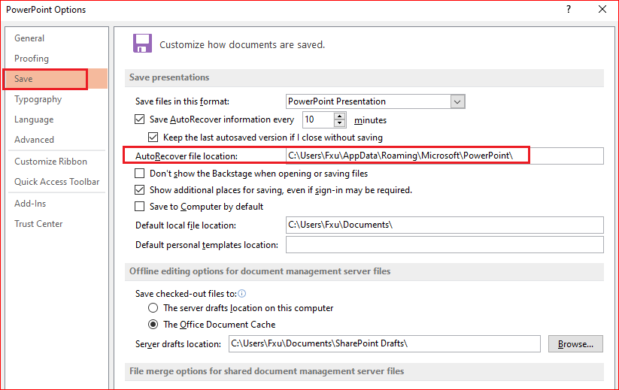
Why need it?

Slide 4
Windows Registry
App2 setting
App1 setting
App3 setting
Windows Registry stores all application settings
in one repository (logical, but a number of discrete files)
in a standardized form
binary file
parsing a binary format is more efficiently
provide backup and restoration service

Slide 5
What is the Registry?
Is a hierarchical database
Stores low-level settings for Window OS
Software and hardware info
settings, options, and other values
Examples: which component uses registry?
The kernel, device drivers, services, Security Accounts Manager (SAM), and user interface

Slide 6


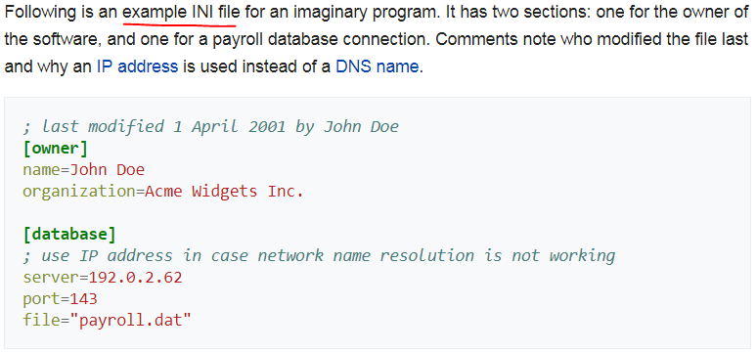
Prior to the Windows Registry
.INI files
stored each program's settings as a text file,
often located in a shared location
App setting
John

Slide 7
Problems with .INI
Did not provide user-specific settings in a multi-user scenario
Not standardized format
Not centralized
One application, one .INI file

Slide 8
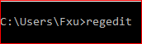
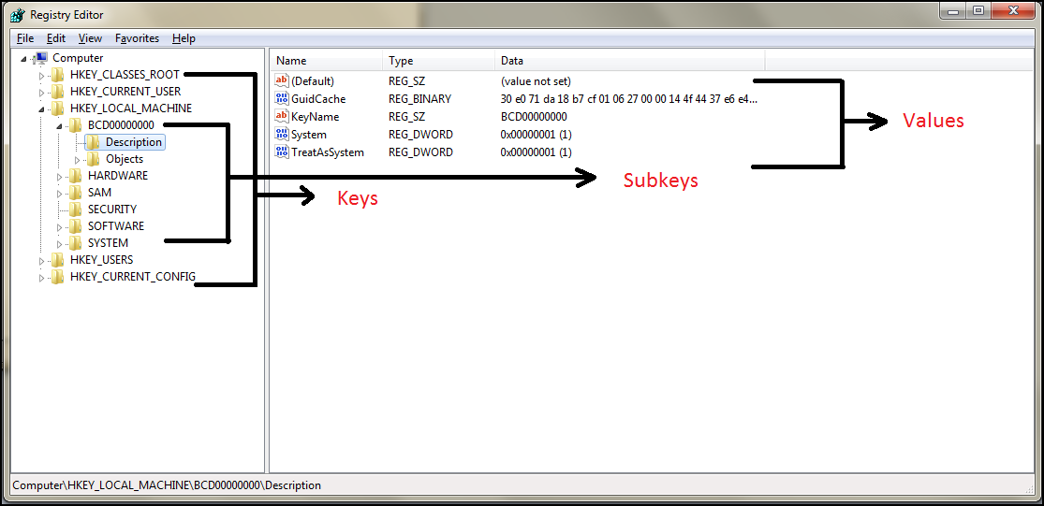
Registry Structure
Handle to Registry Key=Hkey
Keys: folders
Values: files in the folders, and they contain the actual settings.

Slide 9
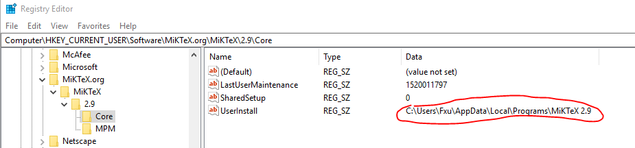
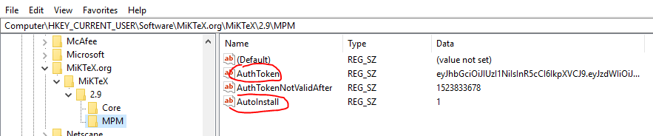
Registry Example

Slide 10
Root Keys

Slide 11
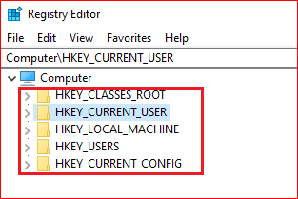

Slide 12
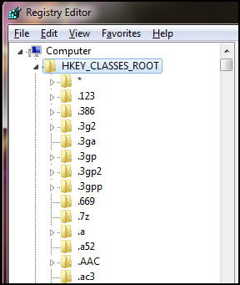
The HKCR keeps track of the file name extension associations and class registrations to connect items with the appropriate application.

Slide 13
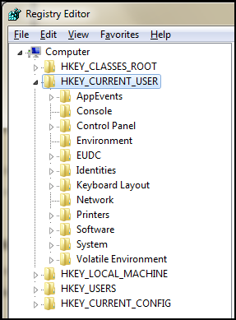
HKCU contains data specific to each user with a logon account on your PC.
It stores information related to the user who is currently logged into the computer.
Right from the appearance aspect to how the mouse pointer behaves, everything can be controlled via this root key.

Slide 14
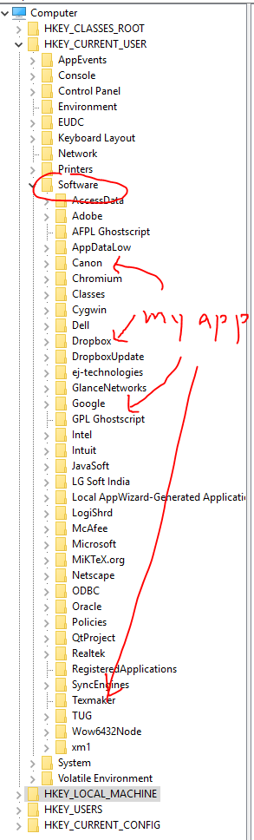
HKEY_CURRENT_USER
The most important sub-key in here is HKCU\Software,
contains user-level settings for most of your software.

Slide 15
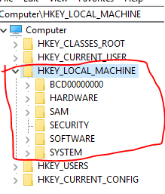
HKEY_LOCAL_MACHINE
All of the system-wide settings
Not stored on disk, but maintained in memory by the system kernel in order to map all the other subkeys.

Slide 16
BCD – This subkey stores, the boot configuration data.
HARDWARE – This subkey contains relevant information on all connected plug-and-play devices.
SAM – This subkey appears empty to most users. It is used with the security and accounts management databases.
SECURITY – This is more security-related information that appears blank to most users.
SOFTWARE – This area is used by both Windows and application programs to store critical configuration settings
SYSTEM – This information is created by users with administrative privileges. It includes the Windows settings, file system information, and critical hardware configurations as well as other information needed to run the core system.
.

Slide 17
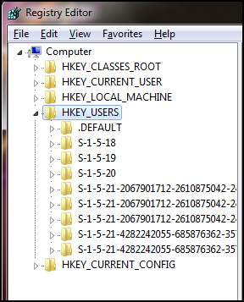
contains information about all the users who has an account the computer
define the default user configuration for new users on the local compute

Slide 18
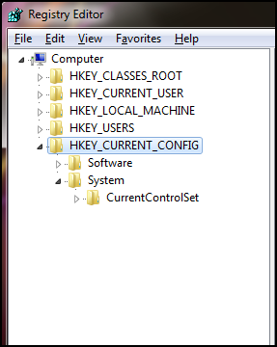
Contains the current hardware profile settings which have the details about the current configuration of hardware attached to the computer.
It is mainly empty and gets activated at boot time, during which it loads the ‘hardware profiles’ sub key of the HKLM.

Slide 19
Demo

Slide 20
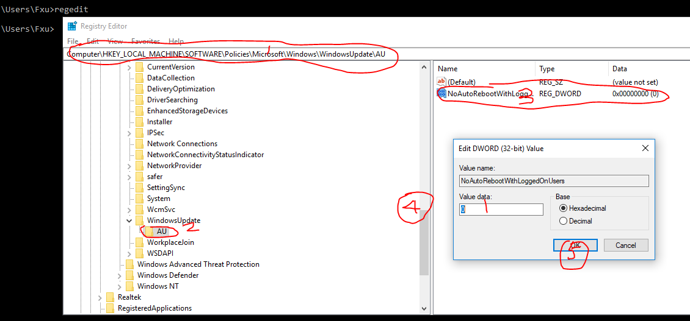
DEMO 1: Prevent Windows Update from automatically restarting your computer

Slide 21
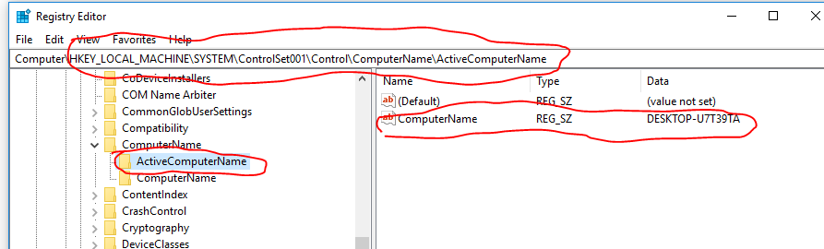
Demo 2: find the computer’s name

Slide 22
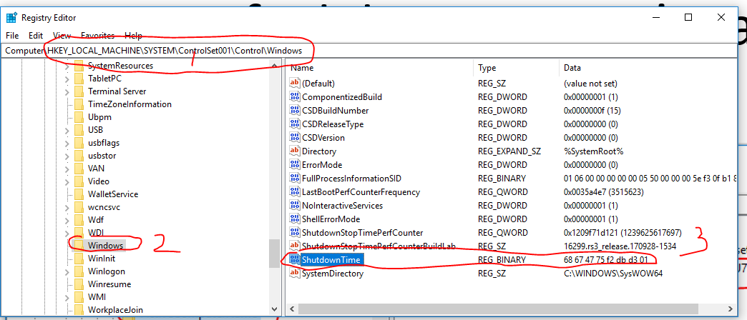
Demo 3: find the time at which the system was last shut down

Slide 23
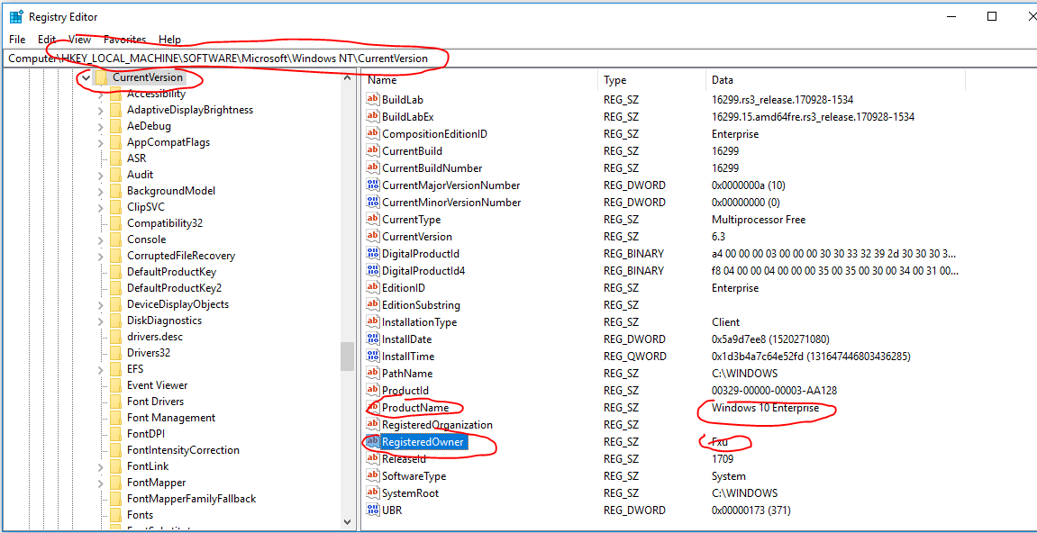
Demo 4: Current Version: provide information about the system

Slide 24
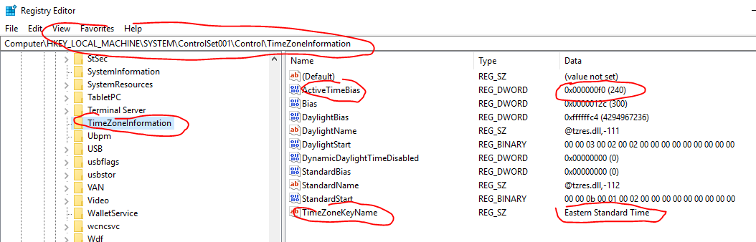
Demo 5: TimeZoneInformation
This information can be extremely important
for establishing a timeline of activity on the system.
ActiveTimeBias
is the current time difference from UTC in minutes, regardless of whether daylight saving is in effect or not. It is this value that helps establish the current time zone settings

Slide 25
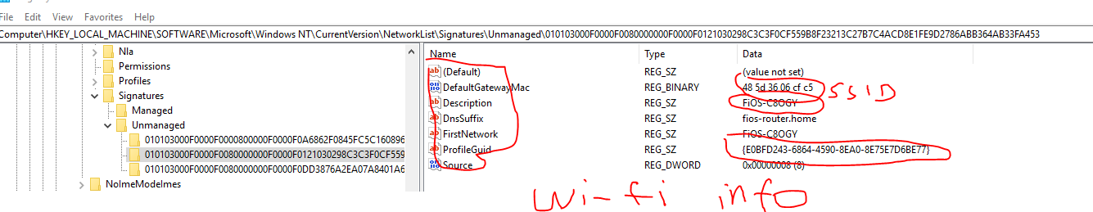
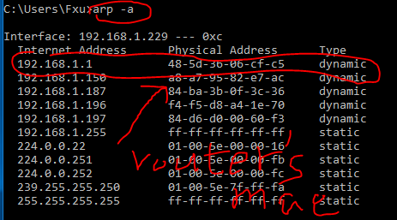
Demo 7: Wi-Fi Information: Gateway Mac, last time connected

Slide 26
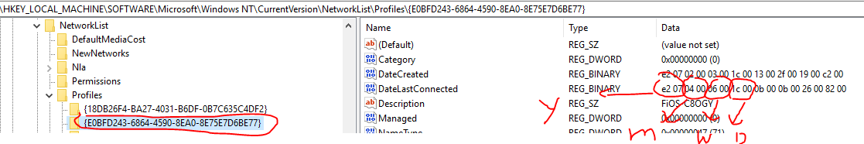
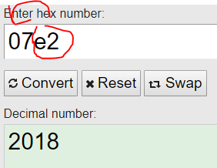
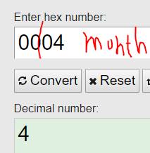
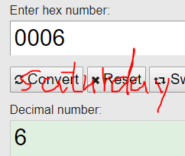
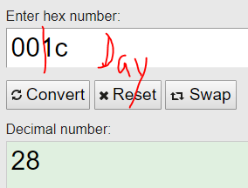


Slide 27
Demo 8: Which USB is attached to PC?
When a USB removable storage device is connected to a Windows system
footprints or artifacts are left in the Registry.
When the device is plugged in, the Plug and Play (PnP) Manager
receives the event and queries the device descriptor in the firmware for information about the device,
such as the manufacturer.
then uses this information to locate the appropriate driver for the device (based on the contents of .inf files) and, if necessary, loads that driver.
Once the device has been identified
a Registry key will be created
Disk&Ven_###&Prod_###&Rev_###

Slide 28
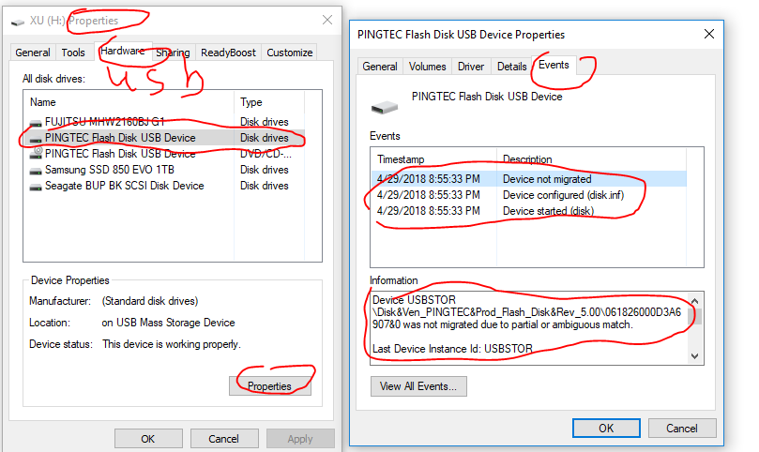
My USB Information

Slide 29
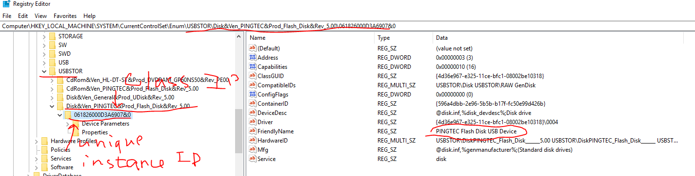
My USB Information in Registry

Slide 30
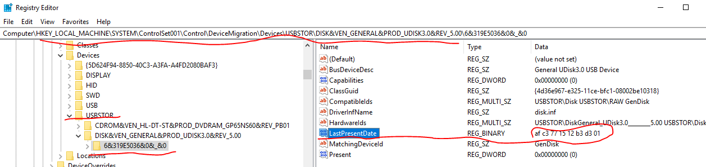
Demo 8: Find Last time the disk was connected to PC
How to decode the LastPresentDate?
Af c3 77 15 12 b3 d3 01
https://stackoverflow.com/questions/43818026/how-decode-windows-64bit-hex-value-little-endian-time

Slide 31
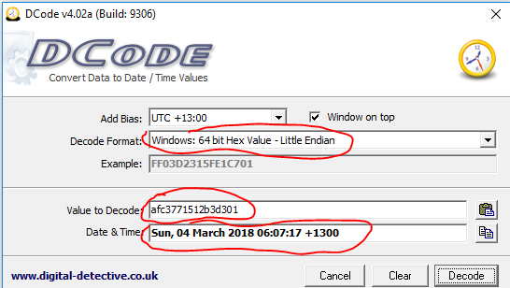
Tip: Decode Window 64 bits hex to date
In unix systems date/time is often (but not always) recorded as a 32-bit integer indicating seconds past since Epoch (00:00:00, Jan 1, 1970).
Windows 64-bit Little Endian format, it means "x100 nanoseconds past since 00:00:00.000,000,0 Jan 1, 1601".

Slide 32
Registry Files Location

Slide 33
Root Keys | Supporting files | Path
HKEY_CURRENT_CONFIG | System.File | %WINDIR%\system32\config\System
HKEY_CURRENT_USER | Ntuser.dat | "Documents and Settings\User”
HKEY_LOCAL_MACHINE\SAM | Sam.File | %WINDIR%\system32\config\Sam
HKEY_LOCAL_MACHINE\Security | Security.File | %WINDIR%\system32\config\Security
HKEY_LOCAL_MACHINE\Software | Software.File | %WINDIR%\system32\config\Software
HKEY_LOCAL_MACHINE\System | System.File
HKEY_USERS\.DEFAULT | Default.File | %WINDIR%\system32\config\default
SAM: Security Accounts Manager

Slide 34
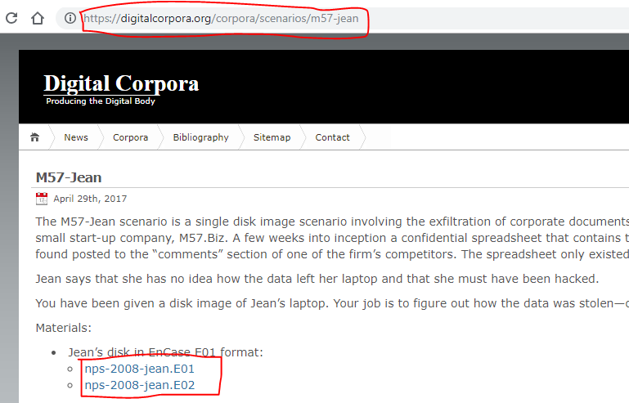
Required files for the lab

Slide 35
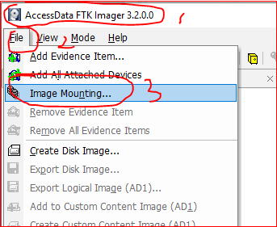
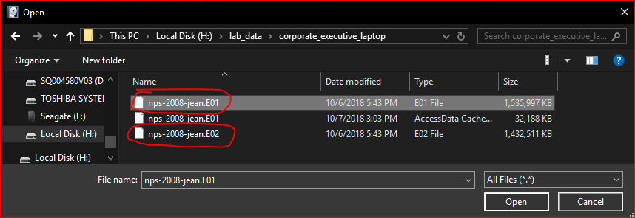

Slide 36
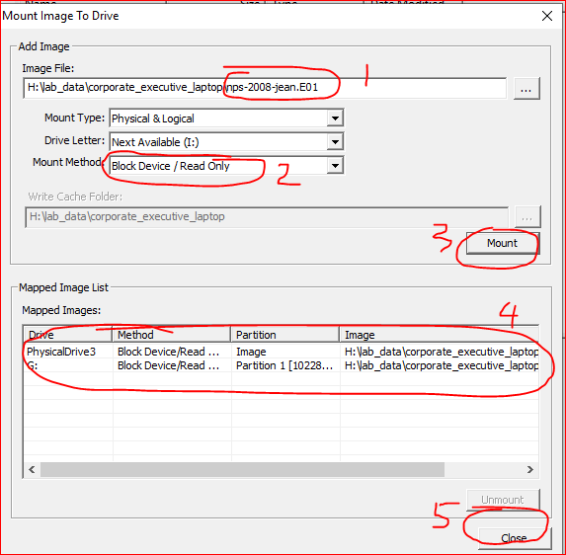
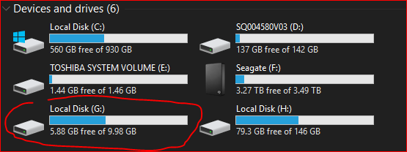
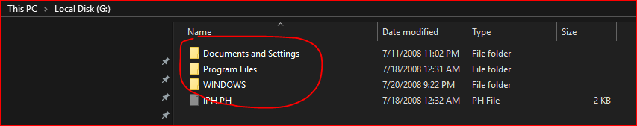

Slide 37


If you can’t find files you are looking for, it is very possible your PC doesn’t show hidden files.
Please read the instructions:
How to Show Hidden Files in Windows 10
https://www.technipages.com/show-hidden-files-windows

Slide 38
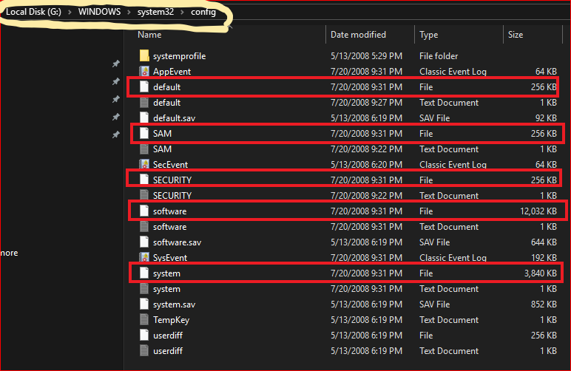
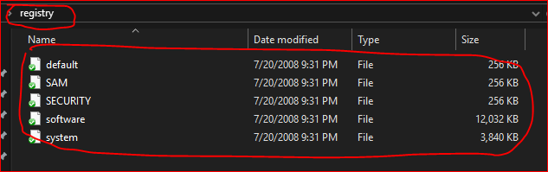
Create a folder “registry” on your Desktop
Copy 5 files to the folder \registry

Slide 39
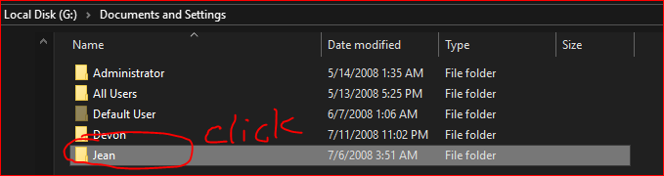
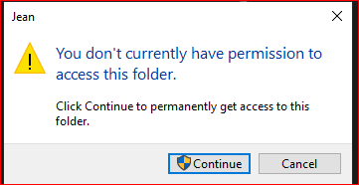
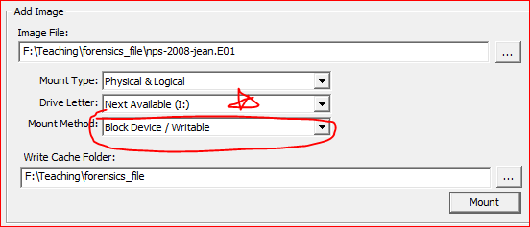
You need to change the setting and remount it!

Slide 40
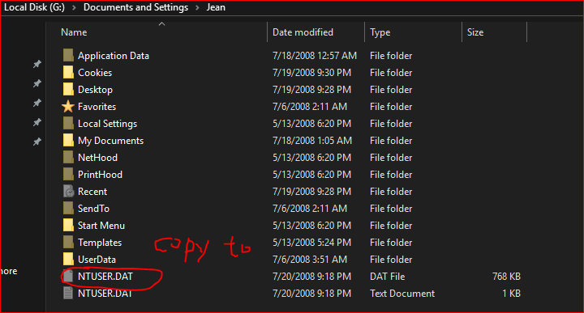
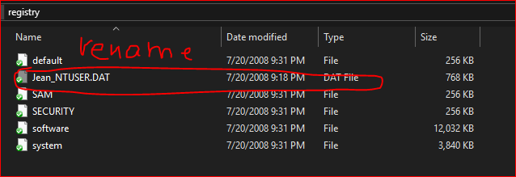

Slide 41
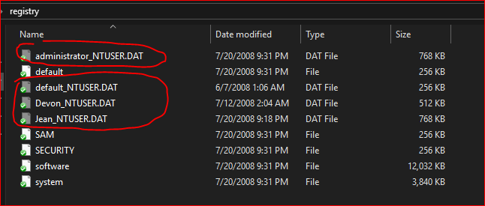

Slide 42
Using Fred to Open Registry Hives

Slide 43
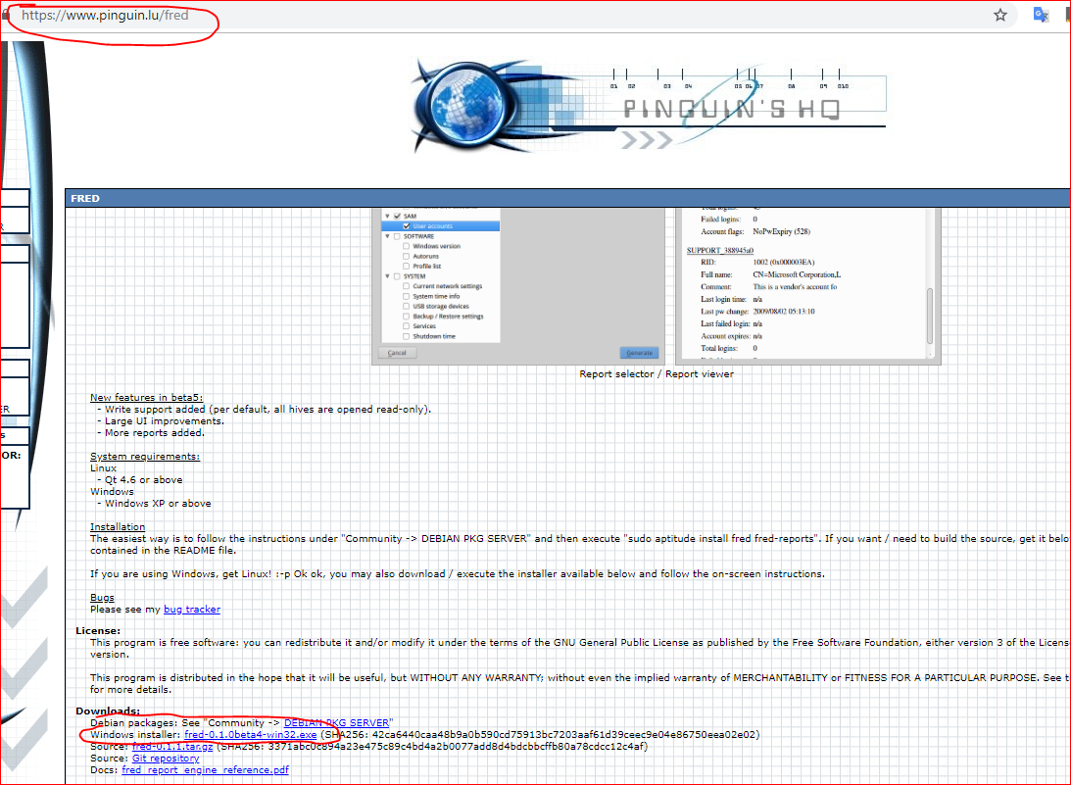

Slide 44
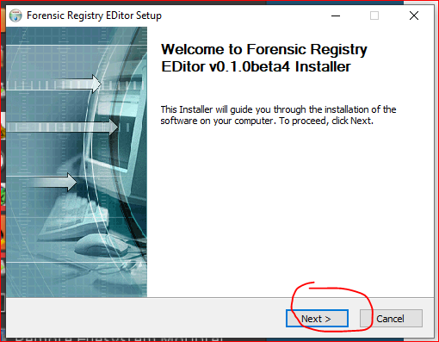

Slide 45

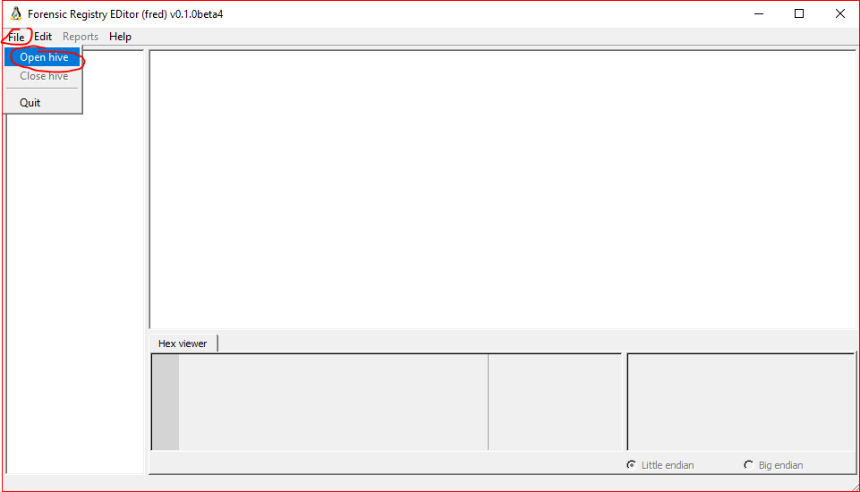

Slide 46
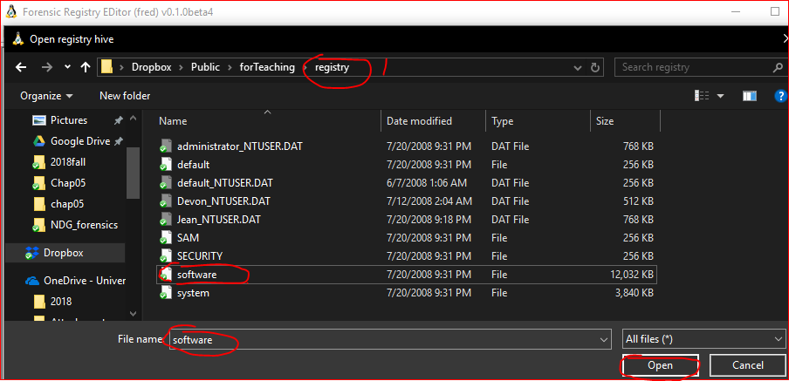

Slide 47
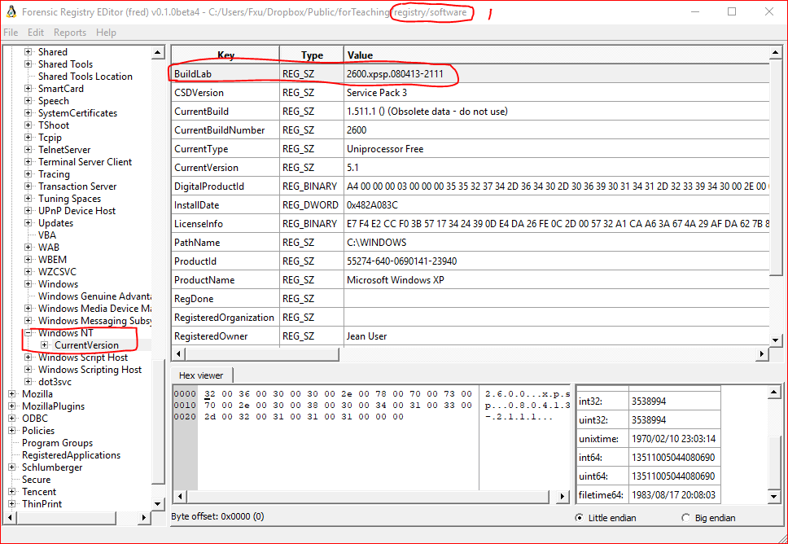
Identify what operating system is being examined
Navigate to Microsoft\Windows NT\CurrentVersion

Slide 48
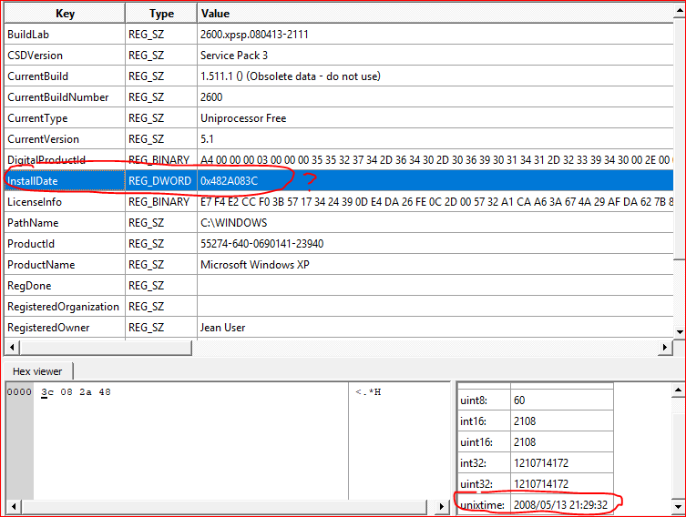
Install Date

Slide 49
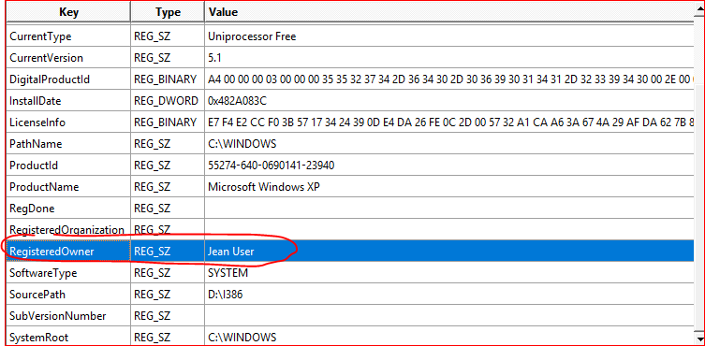

Slide 50

Identify whether the system is set to auto login
Navigate to Microsoft\Windows NT\CurrentVersion\WinLogon

Slide 51
Using Fred to Analyze the SAM Hive

Slide 52


Slide 53


Slide 54
Using Fred to Analyze the System Hive

Slide 55


Slide 56

Identify which control set the machine was using
ControlSet001 and ControlSet002 are alternating backups of CurrentControlSet

Slide 57

Identify the name of the PC

Slide 58

Identify what was mounted on the system

Slide 59

identify if any removable devices have been plugged into the system

Slide 60

Identify when the system was last shutdown
Navigate to ControlSet001\Control\Windows

Slide 61
Using Fred to Analyze the NTUSER.DAT File

Slide 62


Slide 63

Identify the most recently used (MRU) items.
Navigate to Software\Microsoft\Windows\CurrentVersion\Explorer\ComDlg32\LastVisitedPidMRU

Slide 64

Identify the recently saved (MRU) items
Navigate to Software\Microsoft\Windows\CurrentVersion\Explorer\ComDlg32\OpenSavePidMRU\*

Slide 65

Identify the typed URLs in IE
Navigate to Software\Microsoft\Internet Explorer\TypedURLS

Slide 66

Identify the documents that may be most recently used
Navigate to Software\Microsoft\Windows\CurrentVersion\Explorer\RecentDocs

Slide 67

Identify whether any commands were run on the system
Navigate to Software\Microsoft\Windows\CurrentVersion\Explorer\RunMRU

Slide 68
Your work
Analyze your own computer registry by following demo 1 to demo 8 (10 points). You can hide sensitive information if you want.
Finish the lab by following the instructions in the PPTs slides 40-65 (10 points).

Slide 69
Reference
http://www.tweaklibrary.com/2017/04/28/what-are-registry-root-keys/

